Slide 1



Public Health Advocacy Workshops:
A Peer-Led Model for Public Health Education
Sejal Parekh, Public Health Advocates Coordinator
Nell Curran, MPH, School Outreach Director
Marilyn Winkleby, PhD, MPH, Faculty Director
Judith Ned, EdD, MEd, Executive Director
Stanford Medical Youth Science Program (SMYSP)
Stanford Prevention Research Center

Slide 2
Presentation Outline
Teacher-led vs. peer-led public health education
Stanford Health Advocacy Summer Camp
Public Health Advocacy Workshops
  Content & format
  Implementation
  Evaluation
  Dissemination
Discussion

Slide 3
Public Health Education in High Schools
Currently, K-12 health curricula focus on behavior change (smoking, nutrition, safe sex, etc…)
There is limited emphasis on social, economic, and political factors (i.e., upstream causes)
Learning about upstream causes is critical to help students understand and change their health, and the health of their communities

Slide 4
Public Health Advocacy Curriculum
  10 hands-on, interactive, modular lessons
  Freirian pedagogy, project-based learning, think-pair-share
Key messages:
  The health of an individual is embedded within a broad context
  Students can advocate for improved conditions in their school and local neighborhood to help improve personal and community health
3 primary units:
  Upstream Causes of Health
  Community Exploration
  Health and Social Advocacy

Slide 5
Advantages of Teacher-led
Public Health Education
Continuous exposure to public health via consistent implementation of 10 lessons
Taught by teachers who have experience in classroom management and adapting to students learning needs
Captive audience when taught in required classes
Use of school and teacher resources, such as funding and connections to community leaders

Slide 6
Peer-led Education
Peer-led education is contextually defined as “teaching or sharing of information, values, and behaviors by members of similar age or status group” ¹
(Sciacca, 1987).

Slide 7
Need for Peer-led
Public Health Education
Peer education can be cost-effective and convey information accurately¹
Peer education rethinks traditional teaching roles, empowering students to primarily direct their learning through experiential activities, such as community mapping of assets and barriers to health²
Jones, 1992; Peers et al., 1993; Perry, 1989; Clements and Buczkiewicz, 1993; Jarvis 1993.
Catalani and Minkler, 2009; Torres and Noguera, 2008; Turner and Shepherd, 1999.

Slide 8
Advantages of Peer-led
Public Health Education
Flexible format
  Can be taught during lunch, after-school and weekend meetings
  Not limited by class time or teacher availability
Avoids the constraints of state education standards
Capitalizes on the influence teenagers have on each other’s beliefs about health and health behaviors
Student-directed: students choose activities and volunteer service that they find meaningful and enjoy
Students tend to focus on local resources and health issues. This focus gives students a local understanding of public health that they can use to change their personal and community health
Students say it’s more fun!
Notes:
Students say it’s more fun because they feel that they can interact with their friends in an informal environment. In fact, research shows that even when students “teach each other”, the dialogue is very different than when adult teachers teach students

Slide 9
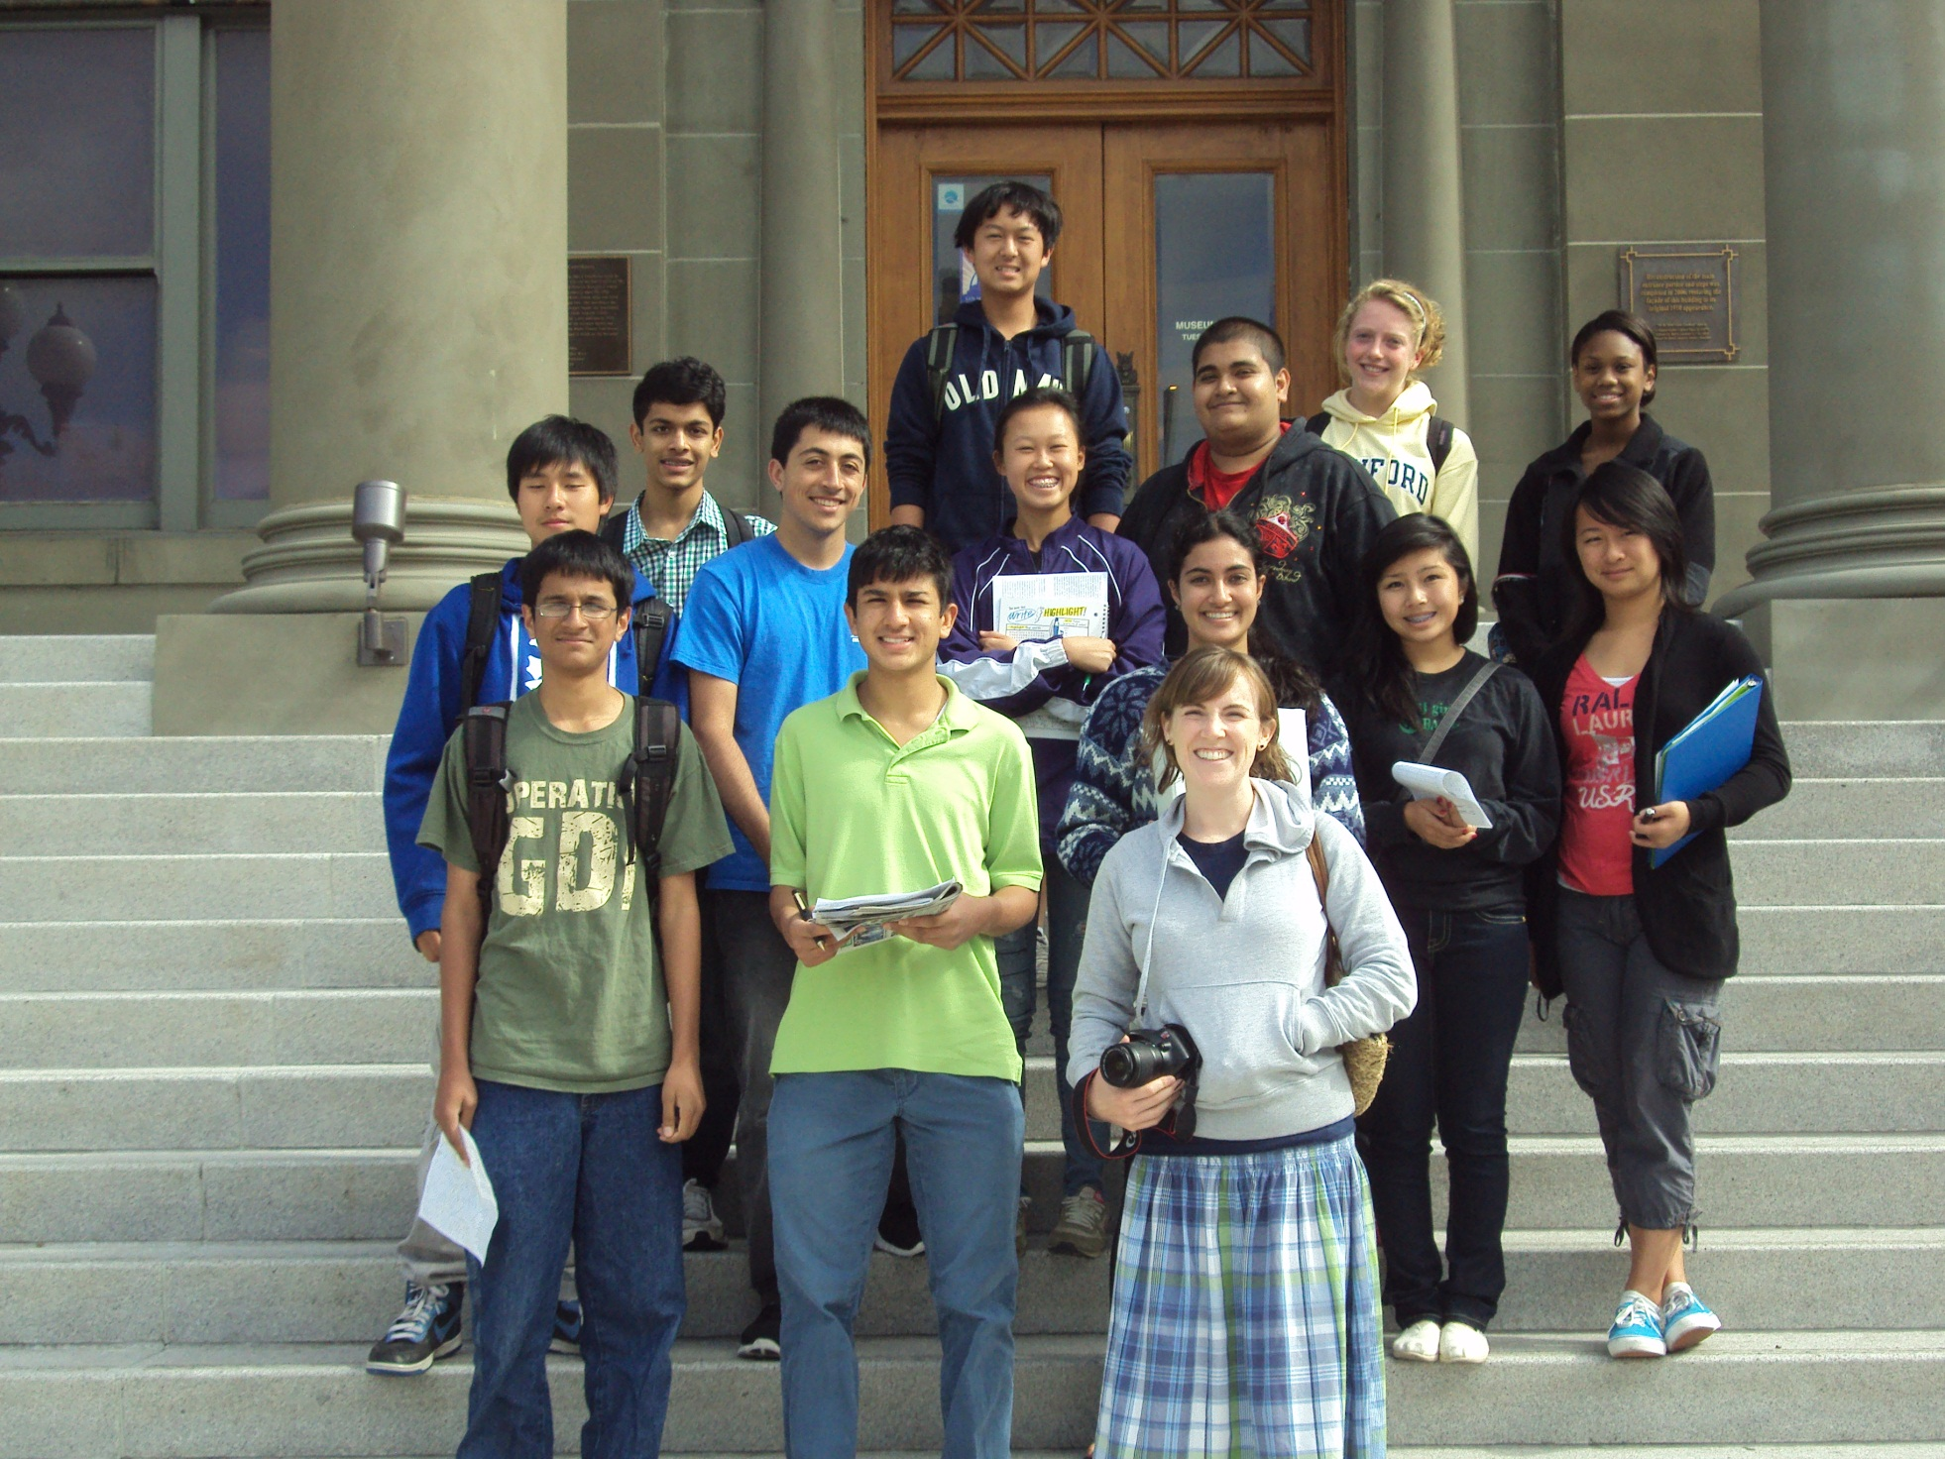

Slide 10
Health Advocacy Summer Camp:
Overview
Adapted the Public Health Advocacy Curriculum content to a summer camp held at Stanford
  Month long, part time (8 meetings)
  Non-residential
  Near-peer-led public health education
Recruited students from Bay Area High schools, based on student interest

Slide 11
Health Advocacy Summer Camp:
Demographics
13 students selected from 8 Bay Area high schools
Average GPA: 3.75
Male | 7
Female | 6
10th grade | 2
11th grade | 8
12th grade | 2
College | 1

Slide 12
Health Advocacy Summer Camp:
Content
Module and case-study based teaching
  Obesity
  Tobacco
  Environmental connections to health
Experiential learning activities
  Health disparities mapping
  City council meeting

Slide 13
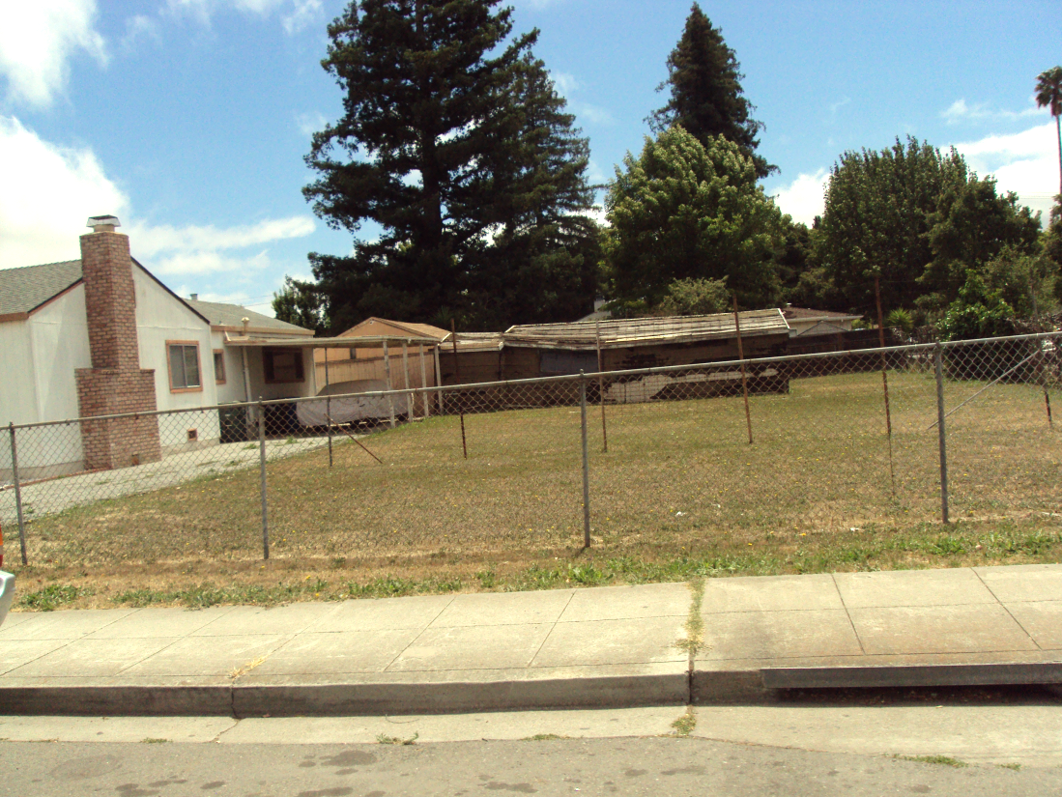
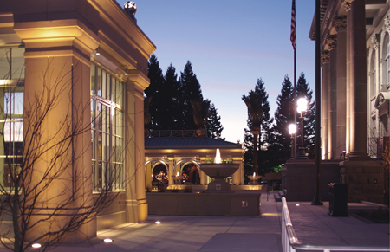
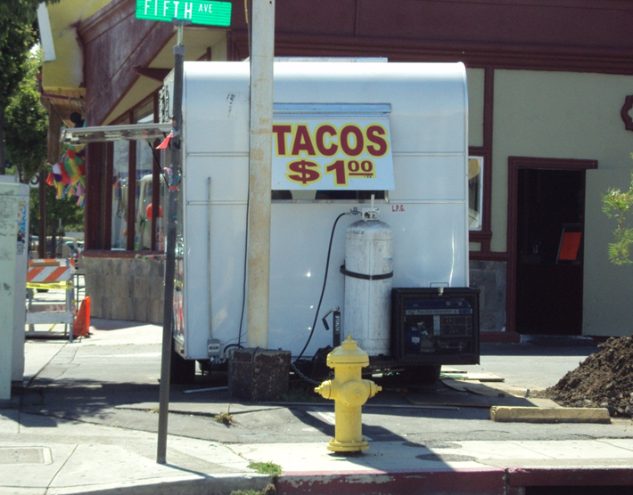
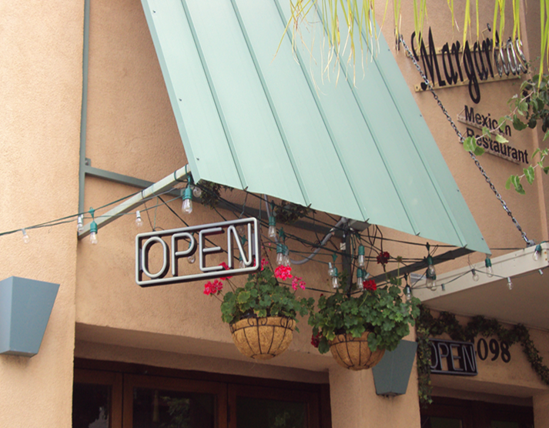
Health Advocacy Summer Camp:
Health Disparities Mapping
“I saw the bike lanes immediately disappear, and new, two-story houses transform into run-down apartment complexes… It was shocking to see how two communities, within the same city and less than a mile from one another, were so different…It dawned on me that the businesses in the communities were the determinants of the communities’ overall health.”
-Female, Junior

Slide 14
Health Advocacy Summer Camp:
City Council Meeting
“Walking into city council I expected a polished meeting, but what the meeting lacked in luster, it made up for in character. I did not expect the council members to allow the city to voice its opinion. When the forum was opened up, I felt that sense of community in EPA come alive. It was one thing to allow the council to vote on large projects and events that I, or other people have never heard of, but by allowing the community to voice itself, we were brought back to a personal level. I loved how the people came to the podium to argue their cases and how they spoke so vehemently about the corruption afflicting the city… From the joking of the mayor to the different neighborhoods, represented, one could see a glimpse of what my city was [-] a collective.” -Male, Senior, EPA resident

Slide 15
Health Advocacy Summer Camp:
City Council Meeting
“My predictions on what the meeting would be [like] was challenged as soon as I walked into the room. Almost immediately, I could feel a sense of community. People were hugging each other, greeting [one] another, discussing city issues, etc. I could tell that the community was well integrated and wanted to work toward solving their problems… the council of East Palo Alto wanted to [get] rid of unused railroad tracks for the purpose of bike lanes. The fact that the council and the city wanted to make bike lanes regardless of the debt told me that they wanted to make the community safer and a better place to live. Although these issues seemed minor, they further emphasized to me that the city really wants to make its community better one and are willing to take steps toward it.” -Male, Sophomore, Non-EPA resident

Slide 16
Health Advocacy Summer Camp:
Student Advocacy Projects
Students researched and created advocacy proposals for a wide variety of topics, such as:
  Plastic bottle usage
  Breastfeeding
  Nutrition in elementary schools
  Physical activity in high schools
  Beef consumption

Slide 17

“So pure, we promise nothing”: a diagnosis of bottled water
By Stephen Chen

Slide 18
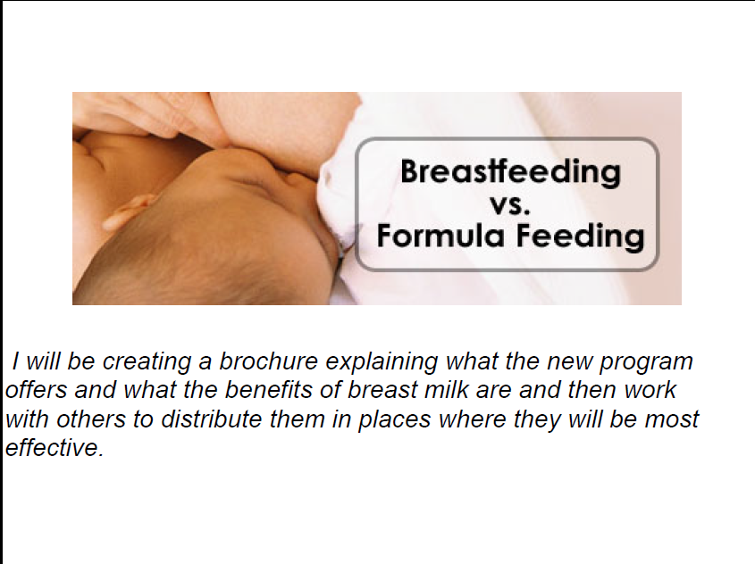

Slide 19
Nutrition
in
School
By Milan Mishra
Stanford Health Advocacy Summer Camp

Slide 20
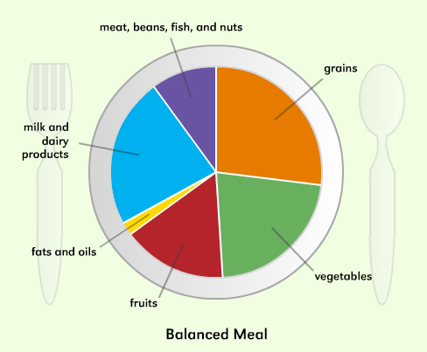
Healthy Plate Posters in Evergreen Elementary
Positioned inside the cafeteria
Influence kids on what choices they make

Slide 21
Project Hypothesis: Concern for grades leads Monta Vista students to exercise less
One Monta Vista student specifically suggested “less worry about grades” to improve P.E. at the school.
Students need exercise, not the stress that comes with P.E. grades.
Notes:
…and through our survey, we have concluded that due to the concern to get the grade, the actual exercise is lost.

Slide 22
Activity Selection
11 out of 17 surveyed students want to select the activities they participate in during P.E.
“[I want to] be able to choose the units/sports played.”
-Monta Vista student
Notes:
Alternate #2: survey participants also expressed a desire to select their own activities. P.E. classes should build off of the current athletic interests of students, and one easy way to do this is to allow students to choose which units they would like to participate in.

Slide 23

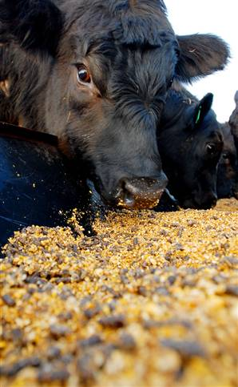
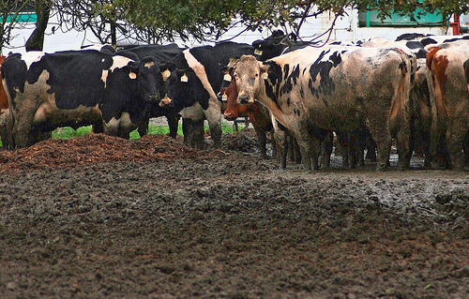
Beef Dangers
Cows are knee deep in their manure
2009, salmonella recall of beef
Bacteria resistant to antibiotics

Slide 24


City-wide Advocacy
To [reduce advertising], I will talk to San Jose city council on fast food advertisements and try to reach a limit [of allowed advertisements]

Slide 25
Health Advocacy Summer Camp:
Evaluation
Quantitative
  Pre and post surveys
  Questions scored on Likert scale 1-5
  (strongly disagree to strongly agree)
  Self-reported data
  Domains: knowledge, skills, self-efficacy
Qualitative
  Open-ended questions about specific activities

Slide 26
Health Advocacy Summer Camp:
Knowledge
I can explain how different aspects of my community can influence health

Slide 27
Health Advocacy Summer Camp:
Skills
I know how to collect information about health issues that may affect my community

Slide 28
Health Advocacy Summer Camp: Self-Efficacy
I am confident that I will be able to work with a community partner to create health-related change in my community

Slide 29
Health Advocacy Summer Camp:
Short-Term Impact
Students were empowered to reach out to and confidently communicate with the following stakeholders in public health:
  Corporations: Nordstrom’s BP Fashion Board
  Government Organization: Santa Clara Valley Water, San Jose City Council, East Palo Alto City Council
  School Administration: Principal of Evergreen Elementary School, School Administration at Saint Francis High School

Slide 30
Health Advocacy Summer Camp:
Long-Term Impact
“Prior to attending SHAC, I had been unsure of what I wanted to study in college…SHAC made me question whether working with people individually would allow me to transform low income communities into economically sustainable and healthy neighborhoods. I ultimately decided a major that combines health and management will prepare me to found a healthcare business that will positively influence the health of residents of all types of communities.” -Female, Junior

Slide 31
Health Advocacy Summer Camp:
Summary
Positive changes in student knowledge, skills, and self-efficacy in public health, and positive anecdotal evidence were documented
Student feedback requesting more opportunities prompted us to create, implement and disseminate a series of Public Health Advocacy Workshops that high school students could teach each other

Slide 32
Public Health Advocacy Workshops

Slide 33
Public Health Advocacy Workshops:
Development
  Adapted from the Public Health Advocacy Curriculum
  Public Health Advocacy Workshops consist of 3 workshops designed to be taught out of class time. The 3 workshops are:
  Understanding Health
  Volunteer Service
  Moving Towards Action
  Student-centered, experiential learning
Key messages:
  An individual’s health and behaviors are strongly affected by the social, political, and economic environment that surround the individual.
  A variety of health interventions (local, global, preventative, curative) exist, and when used appropriately, they can better health outcomes.
  Students can participate in a variety of public health interventions to improve community health.

Slide 34
Public Health Advocacy Workshops:
Format
Taught outside of class time
  As a new after-school club, branch of an existing after-school club, or as part of a class
  Requires 1-3 student leaders
Workshop content was adjusted to include step-by-step instructions for student leaders and a script to read aloud to student participants
  Instructions for student leaders
    Explain that the group will be using a chart to understand the Upstream Causes story.
  Sample directions for student leaders to read aloud to
    → We are interested in understanding why people started drowning in the first place. To organize the different parts of the story, we will be using a chart.

Slide 35
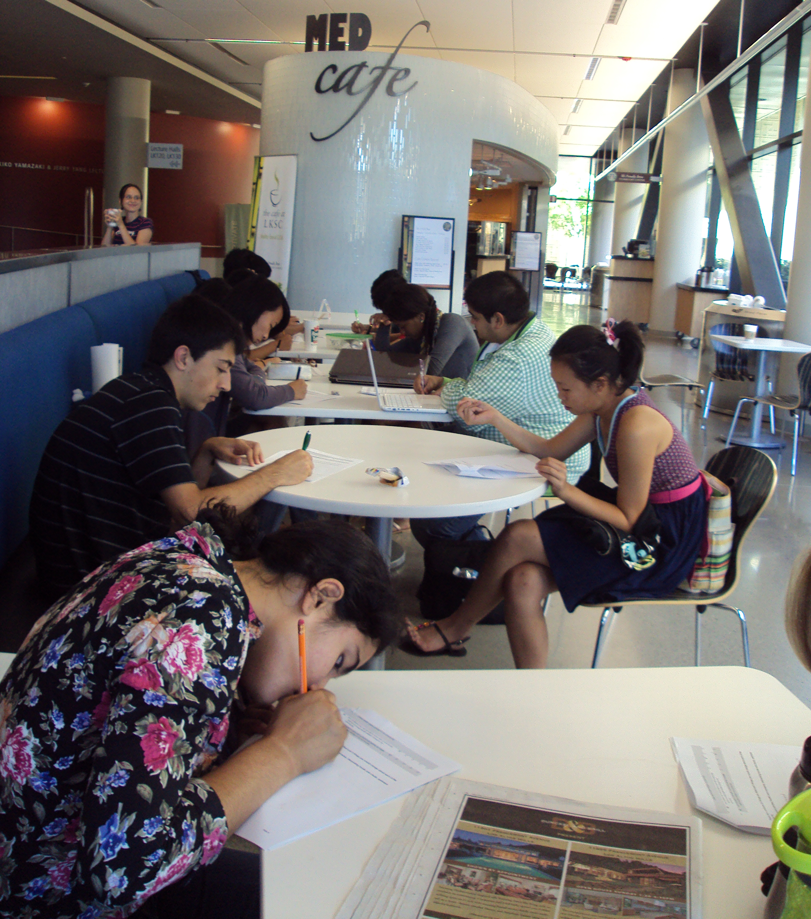
Workshop One: Understanding Health
Overview
Interactive activities and examples that inform students about upstream causes of health and effective health interventions

Slide 36
Workshop One: Understanding Health
Content
Definition of Health: Participants read examples of how different social, economic, and family circumstances contribute to over-all well-being and define “health”
Upstream Causes: Participants read a quintessential public health story that highlights the differences between individual and community health
Case Studies: Participants apply their understanding of upstream causes of health to several case studies. One such case study is about how income and housing affect a young man’s health
Health Interventions: Participants explore the differences between the traditional medical model of curative care and the public health model of prevention in order to better understand the difference between primary, secondary, and tertiary health interventions

Slide 37
Workshop One: Understanding Health
Upstream Causes Flow Chart
Community Influences (social, economic, political factors)
Individual health behaviors
Health or disease risk factors
Health or disease outcome

Slide 38
Workshop One: Understanding Health
Case Study
“Joshua is a young man who was laid off months ago. Recently, he developed cancer. Cancer is caused by carcinogens (chemicals and other substances that cause cancer), which can be found in the air, water, or soil. Unfortunately, Joshua lives next to a landfill, and the toxic waste from the landfill is contaminating the water source that supplies Joshua’s apartment.
Without a paying job, Joshua has less money to spend on rent. Joshua can only afford to live in low-rent apartments. The landfill company requested permission from the local government to allow a landfill to be built on cheaper land.”

Slide 39
Workshop One: Understanding Health
Case Study
Community Influences (social, economic, political factors)
Individual health behaviors
Health or disease risk factors
Lack of Income/
Low Income
Inability to move
Exposure to toxins
Health or disease outcome
Cancer

Slide 40
Workshop One: Understanding Health
Health Intervention
It is October, and Flu Season is about to start. As the City Health Official, you have to decide how to plan for the predicted flu outbreak…

Slide 41
Workshop One: Understanding Health
Health Interventions
Traditional Medical Model
Public Health Model
You decide that anyone with symptoms of the flu is mandated to see a doctor and receive a prescription medication. The patient is also mandated to follow up with the doctor in two weeks after the initial symptoms. In the meanwhile, the patient is allowed to continue work or school, which could help pay the medical bills of seeing a doctor.
You decide everyone aged 2-65 should receive a flu vaccination. You encourage drug stores and doctors’ offices to provide cheap vaccinations for the city. You indicate that flu vaccinations do not necessarily have to be administered by a doctor – they can be delivered by nurses, physician’s assistants, and all other qualified personnel.

Slide 42
Workshop One: Understanding Health
Health Intervention
Policy | Pros | Cons
Medication | -Individualized care reaches only those who have doctors -Can use this doctor’s appointment to ask other medical questions -Likely to cure the patient very quickly | - Doctor’s appointments are time-intensive -Doctor could be overwhelmed with flu patients and not attend to other, more serious patients -Patients are already sick when they are prescribed Tamiflu ©
Vaccinations | -Time-efficient -Doesn’t require a doctor to attend to every patient (nurses give vaccines) -Doctors are too overwhelmed with patients to see each patient individually -Patients avoid sickness altogether -Reach people regardless of medical care | -Some patients could be allergic to the vaccines and have to be treated for their reaction -Some patients could still catch the flu, despite getting the vaccination -Some patients have cultural or religious opposition to vaccinations

Slide 43
Workshop One: Understanding Health
Health Interventions
Secondary Interventions for At-Risk Groups
Primary Intervention for Whole Population
Tertiary
Interventions for
Individuals

Slide 44
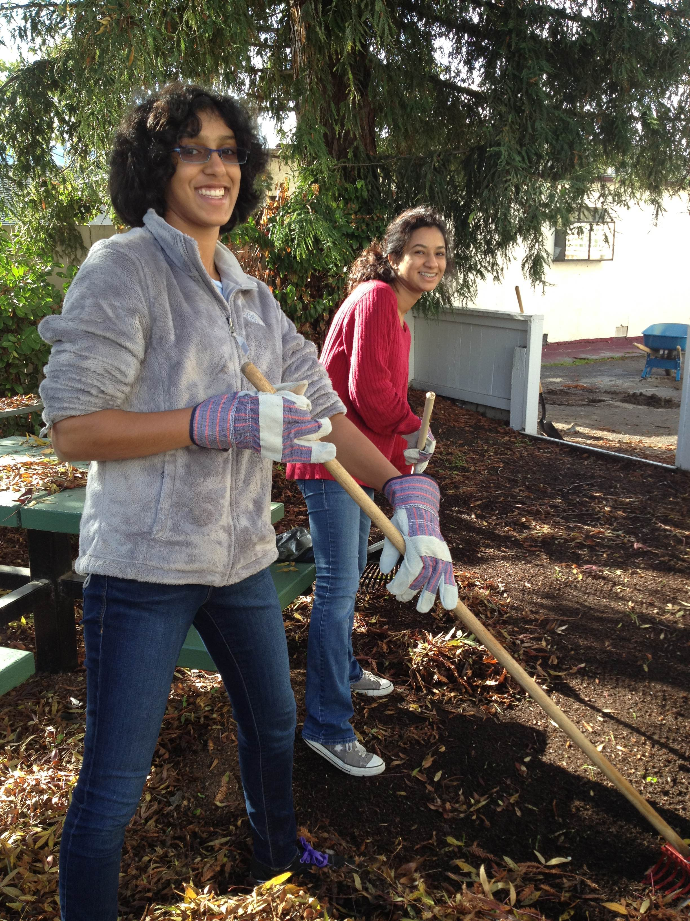
Workshop Two: Volunteer Service
Overview
Participants conduct volunteer service activities to explore their own communities to conduct primary and tertiary health interventions.

Slide 45
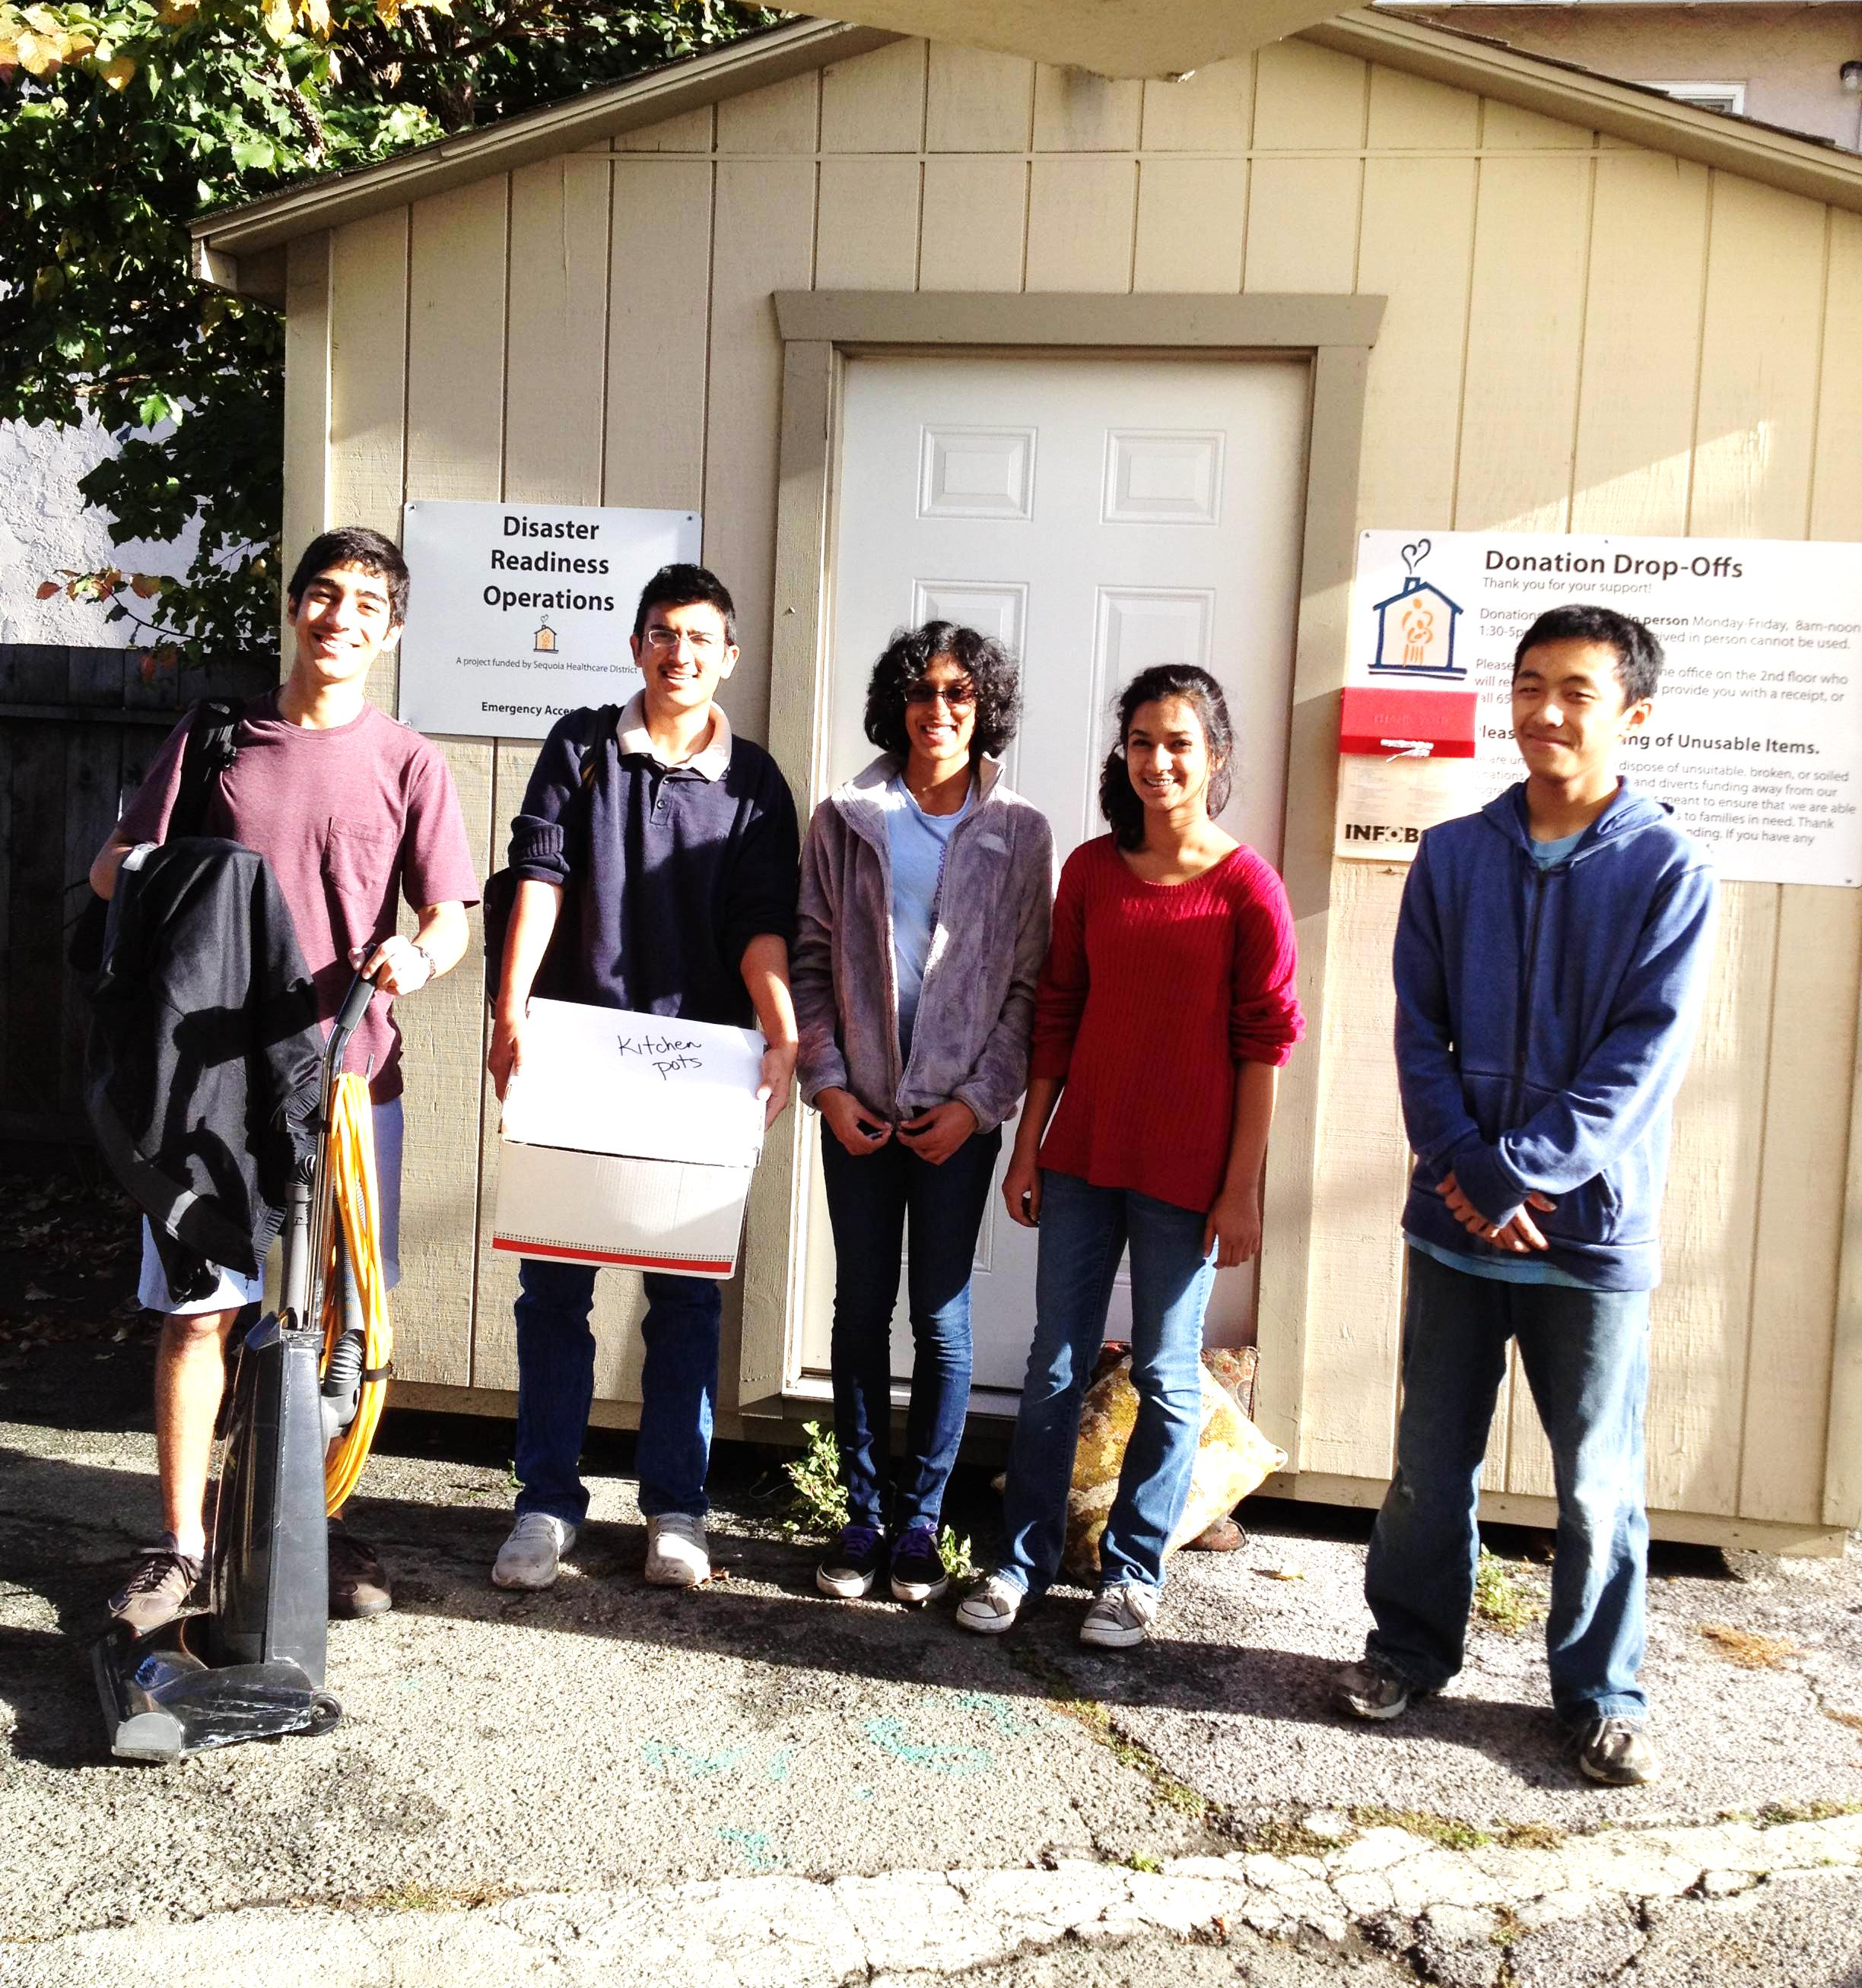
Workshop Two: Volunteer Service
Example
Homeless Shelter:
Participants coordinated a volunteer service activity at a local homeless shelter, where they shadowed staff, organized supplies for future residents, and cleaned the children’s play area. Participants connected upstream causes such as the demand for migrant workers and homelessness with health issues such poor mental health.

Slide 46
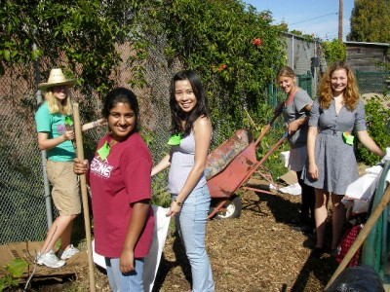
Workshop Three: Moving Towards Action
Overview
Participants brainstorm and define advocacy projects to continue their interest in public health and enhance the health of their communities

Slide 47
Workshop Three: Moving Towards Action
Content
Identifying Local Health Interventions: Participants look through newspaper articles to learn about local organizations and people implementing health interventions
Brainstorming Pledge Ideas: Participants draw on each other’s articles to generate ideas of pledges, or ways they can continue to be involved in public health after the Workshops.
Developing the Pledge: Participants answer a series of guided questions to narrow down their pledge idea. At the end of this activity, participants will have a complete pledge idea.

Slide 48
Workshop Three: Moving Towards Action
Identifying Local Health Interventions
Encourage participants to look for articles that describe how
people or organizations are trying to change the community
influences of the public health issue. Local news articles are
preferred. For example, if the volunteer service was to collect
items for a food drive, one public health issue addressed by this
service is hunger. Participants should look for local news articles
about local people or organizations that are fighting hunger
through a specific means (maybe building a new soup kitchen,
or donating more food).

Slide 49
Workshop Three: Moving Towards Action
Brainstorming Pledge Ideas
Governmental Project: HealthTrust of Santa Clara Valley
Local Activist: Sue Brown
Local Non-Profit Organization: Sacred Heart Food Bank
Local For-Profit Organization: Cicso (holds annual Food Drive)
Public Health Issue: Hunger
Governmental Dept: Department of Health and Human Services
Local Non-profit Organization: Collective Roots
Local Charity: Second Harvest Food Bank
Design a community garden with Collective Roots
Join the Health Trust to work on their existing projects or start a new project
Join Sue Brown’s to increase food and volunteers at soup kitchens
Petition this department to increase their budget for food stamps
Find ways for Second Harvest to donate more fresh foods to the hungry
Find ways for Second Harvest to donate more fresh foods to the hungry
Work with Sacred Heart to recruit more food donors

Slide 50
Workshop Three: Moving Towards Action
Defining the Pledge
This Pledge Development sheet will help you stay involved in efforts to address health issues facing your community, whether you are volunteering with an existing organization or starting your own project.
General Overview
  What health issue do you want to improve in your community?
  Who do you want to interact with to fulfill your pledge?
Volunteering With An Existing Organization
  What did you like about the organization that you did the service through?
  Can you think of organizations that cater to the same people/groups that you want to interact with?
Designing Your Own Project
  What preparation will this project require?
  What type of location do you want to carry out your project in?
  Will you need assistance in carrying out your project? Who are possible people who can help you carry out this project?

Slide 51
Workshop Methods
Implementation
  Recruitment
  Training
  Delivery
  Strengths and Limitations
Evaluation
Dissemination

Slide 52
Workshop Implementation:
Recruitment
To promote the Workshops among high school students, and to recruit student leaders who would be responsible for directing and teaching Workshops at their respective schools, I presented at:
  Career Interest Groups
    Ex: Medical Explorers Weekly Post Meetings
  Cultural Events
    Ex: College Information Fair at cultural events
  High Schools
    Ex: Going to the school to give a “College Information” talk for recruitment

Slide 53
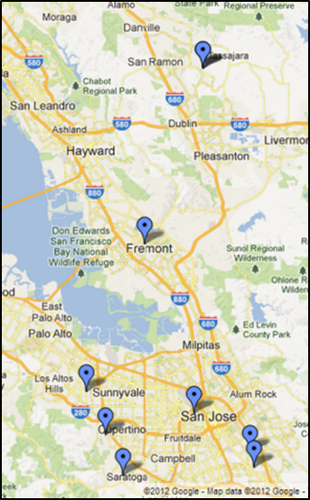
Workshop Implementation:
Recruitment

Slide 54
Workshop Implementation:
Training
Students who expressed committed interest before June 2012 were invited to serve as leaders and attend an in-person training
2 day in-person training for student leaders:
  Role-playing the Workshops
  Thinking about how to teach these Workshops at their high schools (through a new after-school club, as part of an existing after-school club)
  Beginning to contact teachers and administers to gain approval of teaching the Workshops

Slide 55
Workshop Implementation:
Training and Delivery
Name of High School | Number of Student Leaders | Received In-person Training? | How Workshops were taught
Saint Francis High School | 3 | Yes | Did not teach
Andrew Hill High School | 2 | Yes | Created new after-school club
Saratoga High School | 2 | Yes | Taught as part of required class
Los Gatos High School | 5 | No | Created new branch of pre-existing club
Doughtery Valley High School | 4 | No | Created new after-school club
Monta Vista High School | 4 | No | Created new after-school club

Slide 56
Workshop Implementation:
Delivery
Once I confirmed committed student leaders, I
  Supervised through:
    Weekly emails and phone calls for logistic updates
      Club Application
    Monthly Meetings for strategizing
      Finding a teacher moderator
      How to recruit
  Participated through:
    Semester events such as volunteer service

Slide 57
Workshop Implementation:
Strengths and Limitations
Easy Components
Challenging Components
Recruiting student participants
  There seems to be significant interest in health and volunteer service at these schools
Teaching the Workshops
  Student leaders have not reported difficulty or confusion when teaching the Workshop content to student participants
Finding a teacher moderator
  Developing a new after-school club is entirely dependent on finding a teacher moderator willing to supervise the club
Organizing Volunteer Service
  Student leaders are often hampered by issues of transportation and opportunities to communicate with volunteer organizations

Slide 58
Workshop Evaluation:
Overview
Student Participants
Student Leaders
Quantitative
Pre and post survey
  Administered before and after participation in Workshops
  Domains: knowledge, skills, self-Efficacy
  1-5 Likert scale statements
    Self Reported
  Case-based scenarios
    Multiple Choice
    Standardized
Quantitative
  Same as participants
Qualitative
  Semi-structured phone interview
  12 pre-prepared questions
  Typically conducted after student leaders have organized the volunteer service

Slide 59
Workshop Evaluation:
Case-Based Questions
Case studies were developed to gauge students’ understanding of upstream interventions. In this activity, students read the following passage and rank policies that could combat a salmonella outbreak.

Slide 60
Workshop Evaluation:
Case-Based Questions
Imagine you are the city health official who is responsible for dealing with disease outbreaks. Read the following scenario and rank the policies that would most effectively reduce the number of salmonella infections (1-most effective, 4-least effective)
Unfortunately, there is a salmonella outbreak in your city’s elementary school. Symptoms of salmonella infection include vomiting, fever, and diarrhea. Chickens developed Salmonella infections at the farm, which was too crowded and unsanitary. Once chickens were slaughtered on the farm, meat was sent to the factory to be processed. The factory used technology to process the meat and kill most of the Salmonella bacteria. This meat was then sent to the elementary school to be cooked for school lunches. The meat was cooked thoroughly, eliminating most of the Salmonella bacteria, but not all of it. Some of the children who ate the meat became sick with Salmonella infection. The school nurse gave these students rehydration fluids which helped students get better quickly.

Slide 61
Workshop Evaluation:
Case-based Questions
Mandate that all farms have cleaner living areas for chickens.
Provide screening technology to school kitchens to identify contaminated chicken meat.
Prescribe rehydration fluids for all students with salmonella infections to help students feel better.
Set up a Salmonella hotline for parents to get tips on how to care for a child with a Salmonella infection.

Slide 62
Workshop Evaluation:
Interview Questions
Please tell me how you heard about the Public Health Advocacy Workshops?
I’m interested in your role with the Public Health Advocacy Workshops at your high school. Can you tell me about your role?
Did you try to start your own club as the way to bring Workshop series to your school? If so, what was your experience finding a faculty mentor?
Were there any important deadlines you had to meet? What did you do to meet these deadlines?
If you knew of other students who want to teach this Workshops in their high schools, what method (starting new club, joining another club) would you advise other students pursue?
If it’s ok with you, I’d like to talk to you about recruiting members to whom you taught the Workshops. What was the recruiting process like for you? What did you do?

Slide 63
Workshop Dissemination
What’s been done
What we hope to do
Workshops have been posted on SMYSP site
  smysp.stanford.edu
Workshops have been disseminated to students and after-school clubs who have expressed interest
  Partner with career interest groups, health magnet schools, and programs, to spread the message of the Workshops to interested students
  Develop relationships with teachers who would be interested in moderating clubs to teach the Workshops at their high school

Slide 64
Discussion
How do you think students can be supported as they attempt peer-education?
What public health efforts exist at your school?
How could the Workshops be utilized in your school?
Where do you locate resources for public health and other lessons?
Other questions?

Slide 65
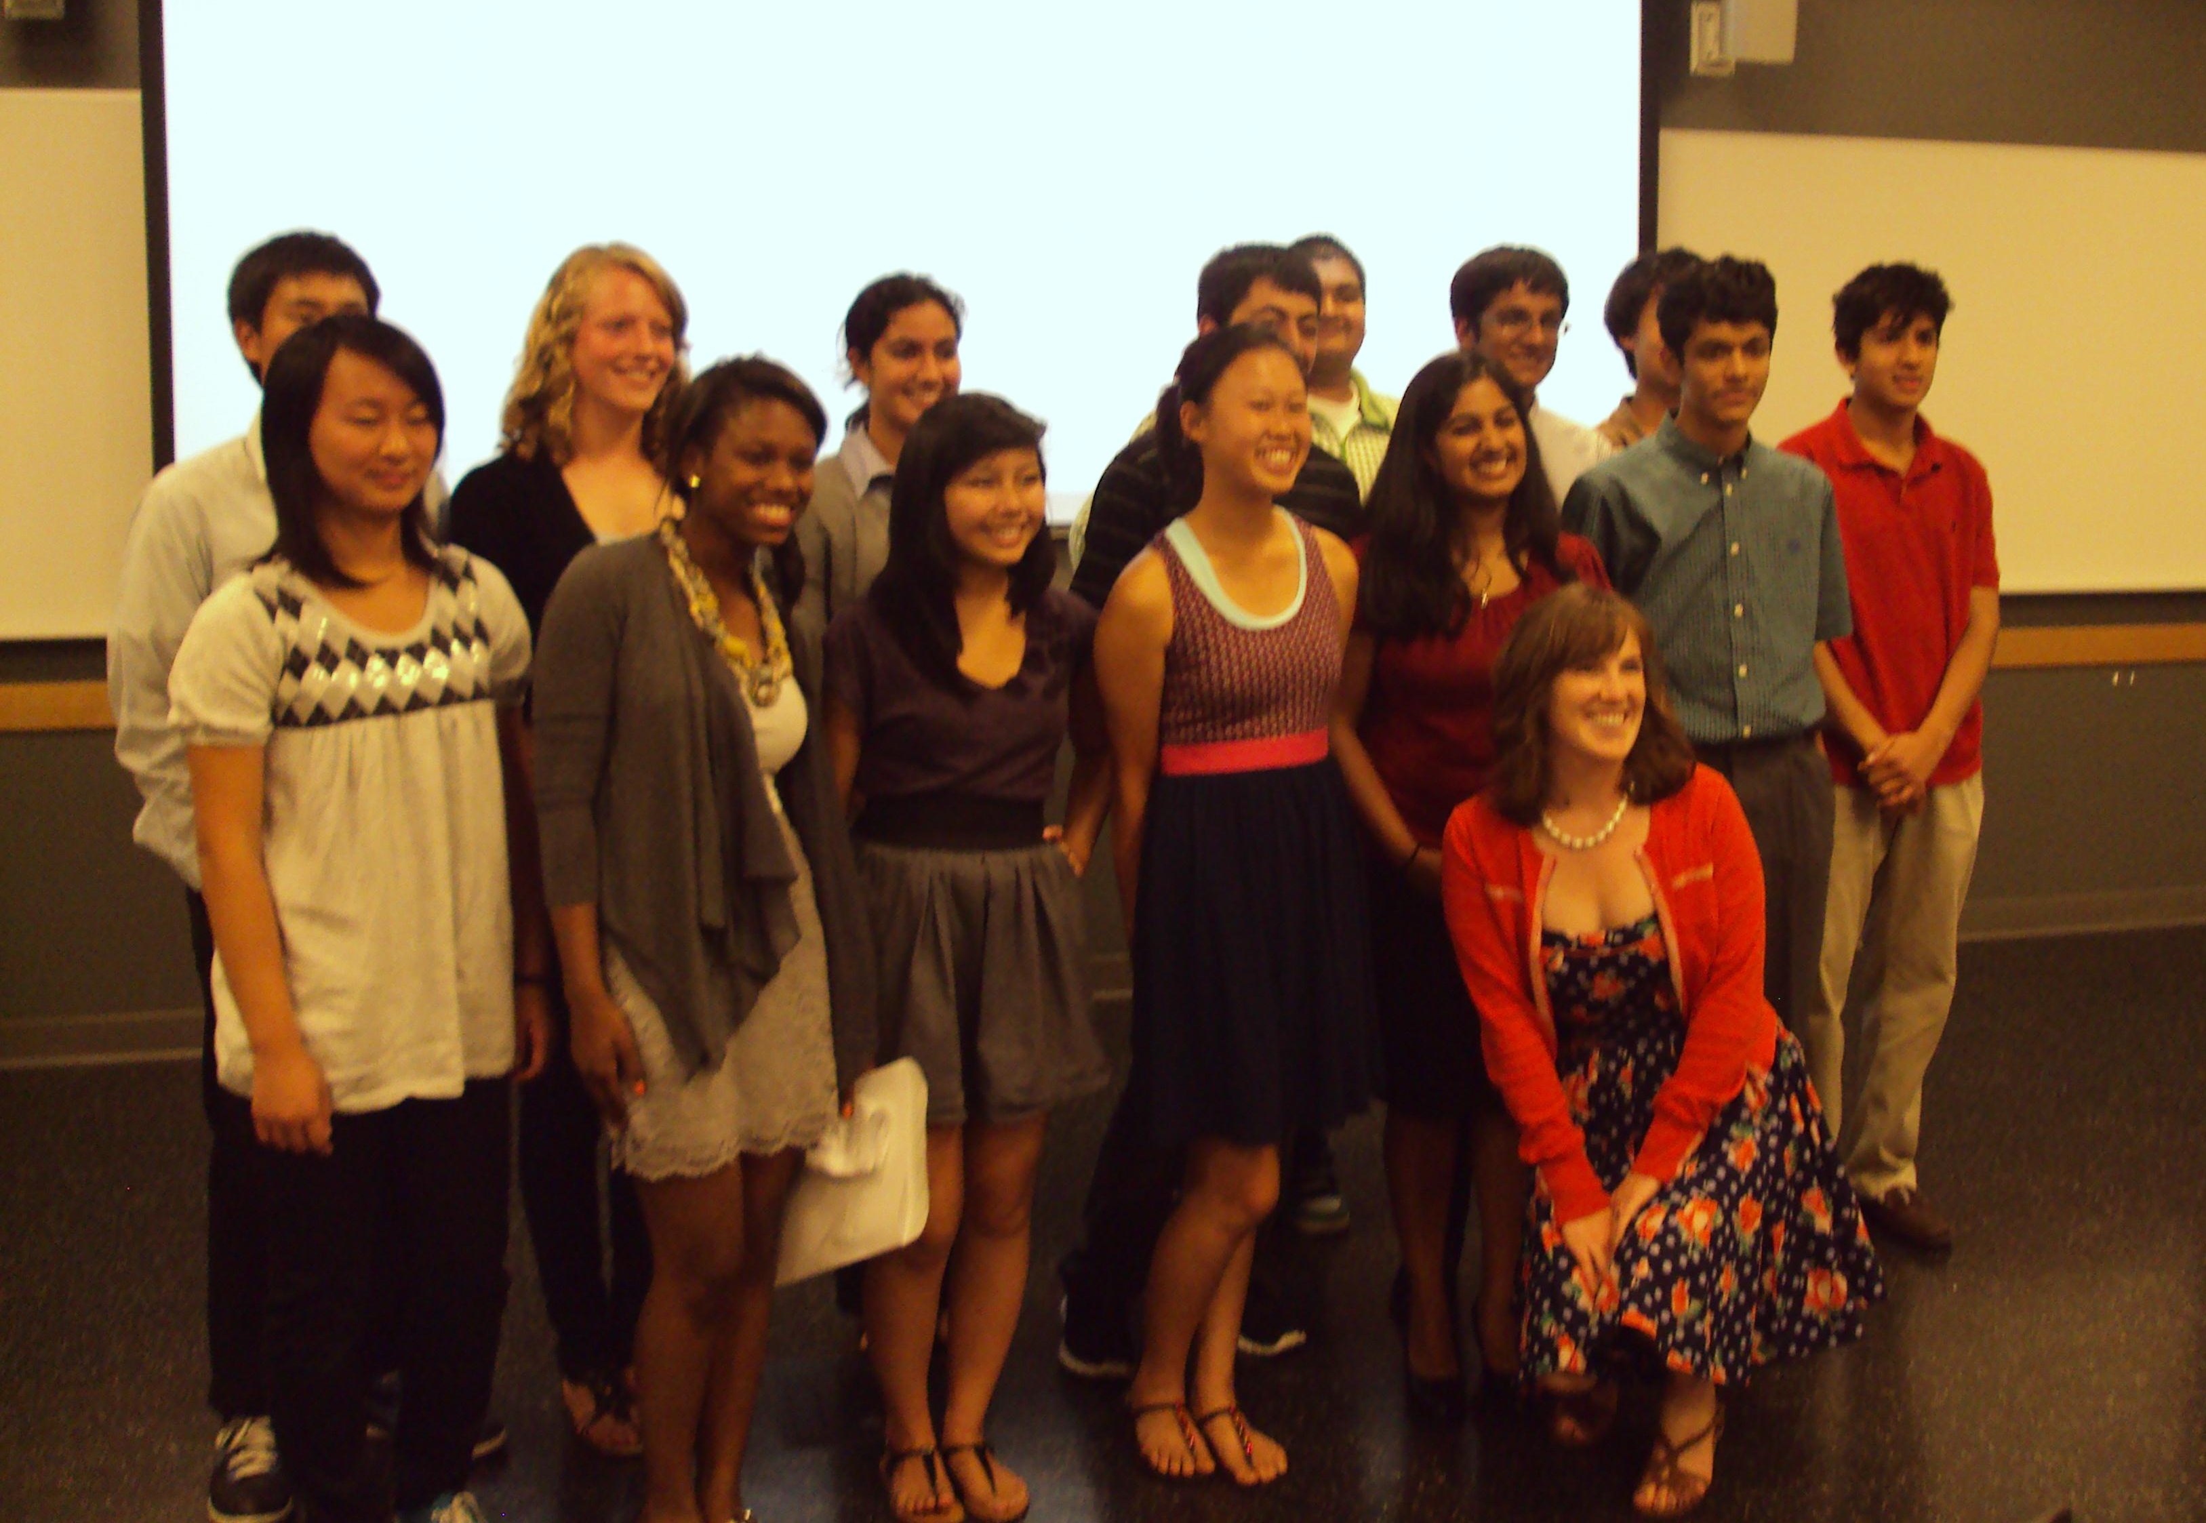
Thank You

